Slide 1
Computer Networks: Unit 1
Prof. Swarnalata Bollavarapu
Contact: swarnalata.b@nmims.edu

Slide 2
Contents
Communicating in a network centric world
Network as a platform
Architecture of the Internet
Classification of Networks
Layered Models
Network Addressing
Components of Network
Topology
Transmission modes
Internetworking devices
Ref Book: Mark Dye et.al, “Network Fundamentals”, CCNA Exploration Companion Guide, Cisco Press

Slide 3
H/W Q1
How many nodes were part of the ARPANET in 1969?
A) 4
B) 5
C) 6
D) 3

Slide 4
H/W Q2
Who is/are called the father/father’s of the Internet?
A) Donald Davies and Leonard
B) Robert Metcalfe
C) Kahn and Cerf

Slide 5
H/W Q2
In which year Ethernet was invented?
A) 1962
B) 1955
C) 1980
D) 1973

Slide 6
Communicating in a network centric world
Computer Network: It is a collection of autonomous computers interconnected by a single technology.
Two computers are said to be interconnected if they are able to exchange information .
The connection can be via any media(wired/wireless)
Networks come in many sizes, shapes and forms

Slide 7
Communicating in a network centric world
Communication is almost as important to us as our reliance on air, water, food, and shelter.
Methods that we use to communicate are constantly changing and evolving
Breakthroughs in technology have significantly extended the reach of our communications
Each new development has improved and enhanced our ability to connect and communicate with others.
One cannot even imagine a life without Internet today

Slide 8
Communicating in a network centric world
On daily basis,
Post and share your photographs, home videos, and experiences with friends or with the world
Communicate with friends, family, and peers using email, instant messaging, or video applications
Watch videos, movies, or television episodes on demand
Play online games with friends
check weather conditions
Find the least congested route to your destination
Check your bank balance and pay bills electronically

Slide 9
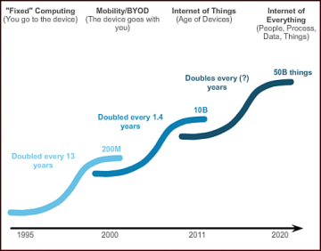
Communicating in a network centric world

Slide 10
Communicating in a network centric world
Significant impact:
1. Network support the way we learn:
2. Network support the way we communicate:
3. Network support the way we work:
4. Network support the way we play:
Whatever form it may be, networks are improving our experience

Slide 11
Communicating in a network centric world
What is communication?
How do humans communicate?
agreement on a common method
agreement on a common language
Confirmation of message
A communication protocol is a system of rules that allow two or more entities of a communications system to transmit information via any kind of variation of a physical quantity.
The protocol defines the rules, syntax, semantics and synchronization of communication and possible error recovery methods.

Slide 12
Communicating in a network centric world
What is communication?
Quality of Communication:
External factors- related to the complexity of the network and the number of devices a message must pass through
Eg., The number of other messages being transmitted simultaneously on the communication network
Internal factors-elated to the nature of the message itself.
eg., The size of the message

Slide 13
Network as a platform
Our dependency of networks has become essential for personal as well as business lives
Networks are the platforms on which to run businesses, to address emergencies, to inform individuals, and to support education, science, and government.

Slide 14
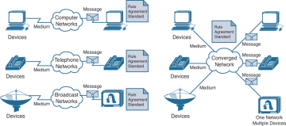
Network as platform
Early data networks were limited to exchanging character-based information between connected computer systems.
Current networks have evolved to carry voice, video streams, text, and graphics between many different types of devices.

Slide 15
Network as platform
Four basic characteristics that the N/w architectures need to address in order to meet user expectations:
Fault tolerance: how networks can manage unexpected equipment failure
Scalability: a network that will be able to efficiently expand
QoS: network can prioritize network traffic to provide users with reliable quality of service,
Security: securing information as well as n/w infrastructure

Slide 16
Components of network
End devices: interface between users and the underlying communication network.
Eg., Computers (work stations, laptops, file servers, web servers)
A host device is either the source or destination of a message transmitted over the network.
Intermediary devices: interconnect end devices, multiple individual networks
Eg.,switches, routers
Network media: The medium provides the channel over which the message travels from source to destination.
Eg., Copper wires, fiber-optic cables and wireless transmission

Slide 17
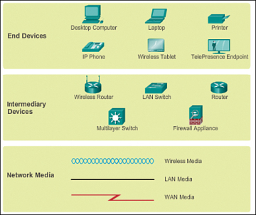
Components of network
Network representation:
A diagram provides an easy way to understand the way the devices in a large network are connected, known as topology diagram

Slide 18
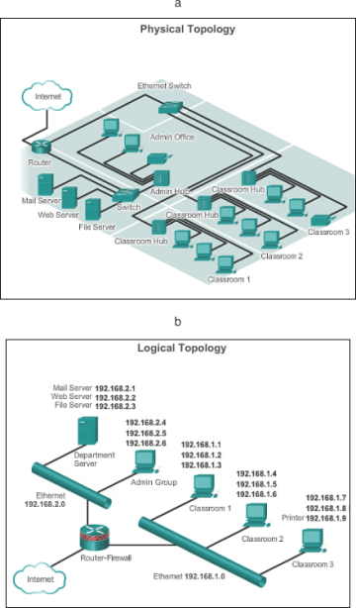
Topology
Network topology is the
physical interconnection of
the elements of a computer
Network
Types:
Bus
Ring
Star
Mesh
Hybrid

Slide 19
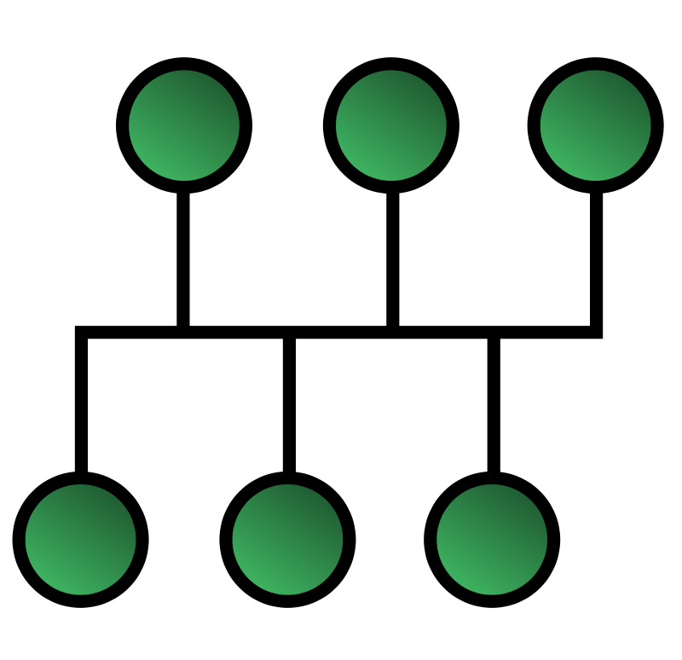
BUS Topology
In a bus network, every device is connected to a single cable that runs from one end of the network to the other
at any instant at most one machine is the master and is allowed to transmit.
All other machines are required to refrain from sending.
Some mechanism is needed to resolve conflicts when two or machines want to transmit simultaneously.
For example : IEEE 802.3, Ethernet.
Computers on an Ethernet can
transmit when ever they want to;
if two or more packets collide,
each computer just waits a random
time and tries again later.

Slide 20
RING Topology
each computer is connected to the network in a closed loop or ring.
Each machine or computer has a unique address that is used for identification purposes.
The signal passes through each machine or computer connected to the ring in one direction.
Ring topologies typically utilize a token passing scheme, used to control access to the network.
By utilizing this scheme, only one machine can transmit on the network at a time.

Slide 21
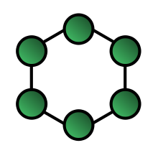
RING Topology
The machines or computers connected to the ring act as signal boosters or repeaters which strengthen the signals that transverse the network.
The primary disadvantage of ring topology is the failure of one machine will cause the entire network to fail.

Slide 22

Star Topology
every node is connected to a central node called a hub or switch

Slide 23
Components of network
Important terms:
Network interface card (NIC): Provides the physical connection to the network at the PC or other host device. The media connecting the PC to the networking device plugs directly into the NIC (also known as a LAN adapter).
Physical port: A connector or outlet on a networking device where the media is connected to a host or other networking device.
Interface: Specialized ports on an internetworking device that connect to individual networks. Because routers are used to interconnect networks, the ports on a router are referred to as network interfaces.

Slide 24
Types of Network
Depends on:
Size of the area covered
Number of users connected
Number and types of services available
Types:
LAN
MAN
WAN
Wireless network
Internet

Slide 25
Types of Network: LAN
spans a small geographical area
LANs interconnect end devices in a limited area such as a home, school, office building, or campus.
A LAN is usually administered by a single organization or individual. The administrative control that governs the security and access control policies are enforced on the network level.
LANs provide high-speed bandwidth to internal end devices and intermediary devices.
LANs run at speed s of 10 Mbps to 100 Mbps.
Newer LANs operate upto 10 GBPs.

Slide 26
Types of Network: MAN
A network infrastructure that spans a physical area larger than a LAN but smaller than a WAN (for example, a city).
MANs are typically operated by a single entity such as a large organization.
Example: A MAN is the cable television network available in many cities.

Slide 27
Types of Network: WAN
spans a wide geographical area.
WANs interconnect LANs over wide geographical areas such as between cities, states, provinces, countries, or continents.
WANs are usually administered by multiple service providers.
WANs typically provide slower-speed links between LANs.

Slide 28
Concluding Remarks
H/W:

